Slide 1
Welcome Principals, Directors and Enrollment Management Team Members

Slide 2
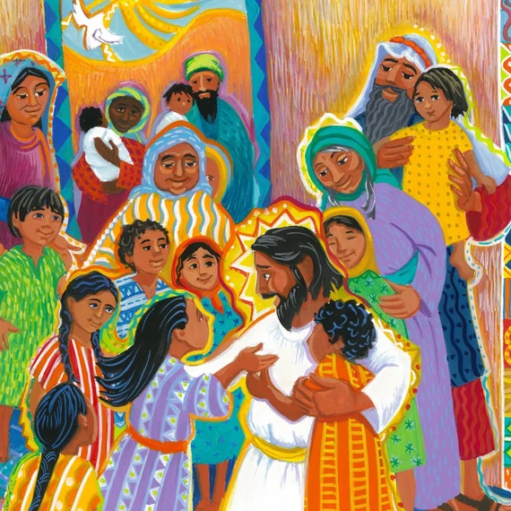
Prayer
Almighty God,
You sent forth your Son as a beacon of hope for all people.
As a Teacher, He has given us the prime example of the importance of education. As disciples, we look to him for inspiration and strength.
Thank you for the many people who have dedicated their lives in service to our Catholic Schools.
Thank you for the teachers and administrators who sustain our schools.
Thank you for the parents who have given support and witness to the importance of Catholic education.
Thank you for the students who work hard to further their education. Bless all our Catholic Schools and the many people who advance our mission.
May our schools be a home for those who seek to grow in openness, faith, love, intellect and commitment to justice.
In your name, we pray. Amen.
Notes:
Prayer before Meetings
Heavenly Father, as we enter into this meeting, we bring your presence with us. We speak your peace, your grace, your mercy, and your perfect order. We acknowledge your power over all that will be spoken, thought, discussed, decided, and done during our meeting.
Lord, we thank you for the gifts you have given to us and we commit to using them responsibly in your honor. Give us a fresh supply of strength and compassion to do our job. Anoint our plans, ideas, and energies so that even our smallest accomplishment may bring you glory.
Lord, when we are confused, guide us, when we are anxious, comfort us, and when we are tired, infuse with the fire of the Holy Spirit.
May the work that we do and the way we do it bring faith, joy, and hope to all of those we serve today and every day.
We ask this through your son, Jesus Christ.
Amen.

Slide 3
Enrollment Management Team Training Session 2 2023-24

Slide 4
Our Learning Goal… Enrollment Management Teams
Enrollment Management Team
Members will be able to…
Celebrate current strengths and powerful practices in enrollment
Identify opportunities for growth
Implement immediate steps to recruit and retain students and families

Slide 5
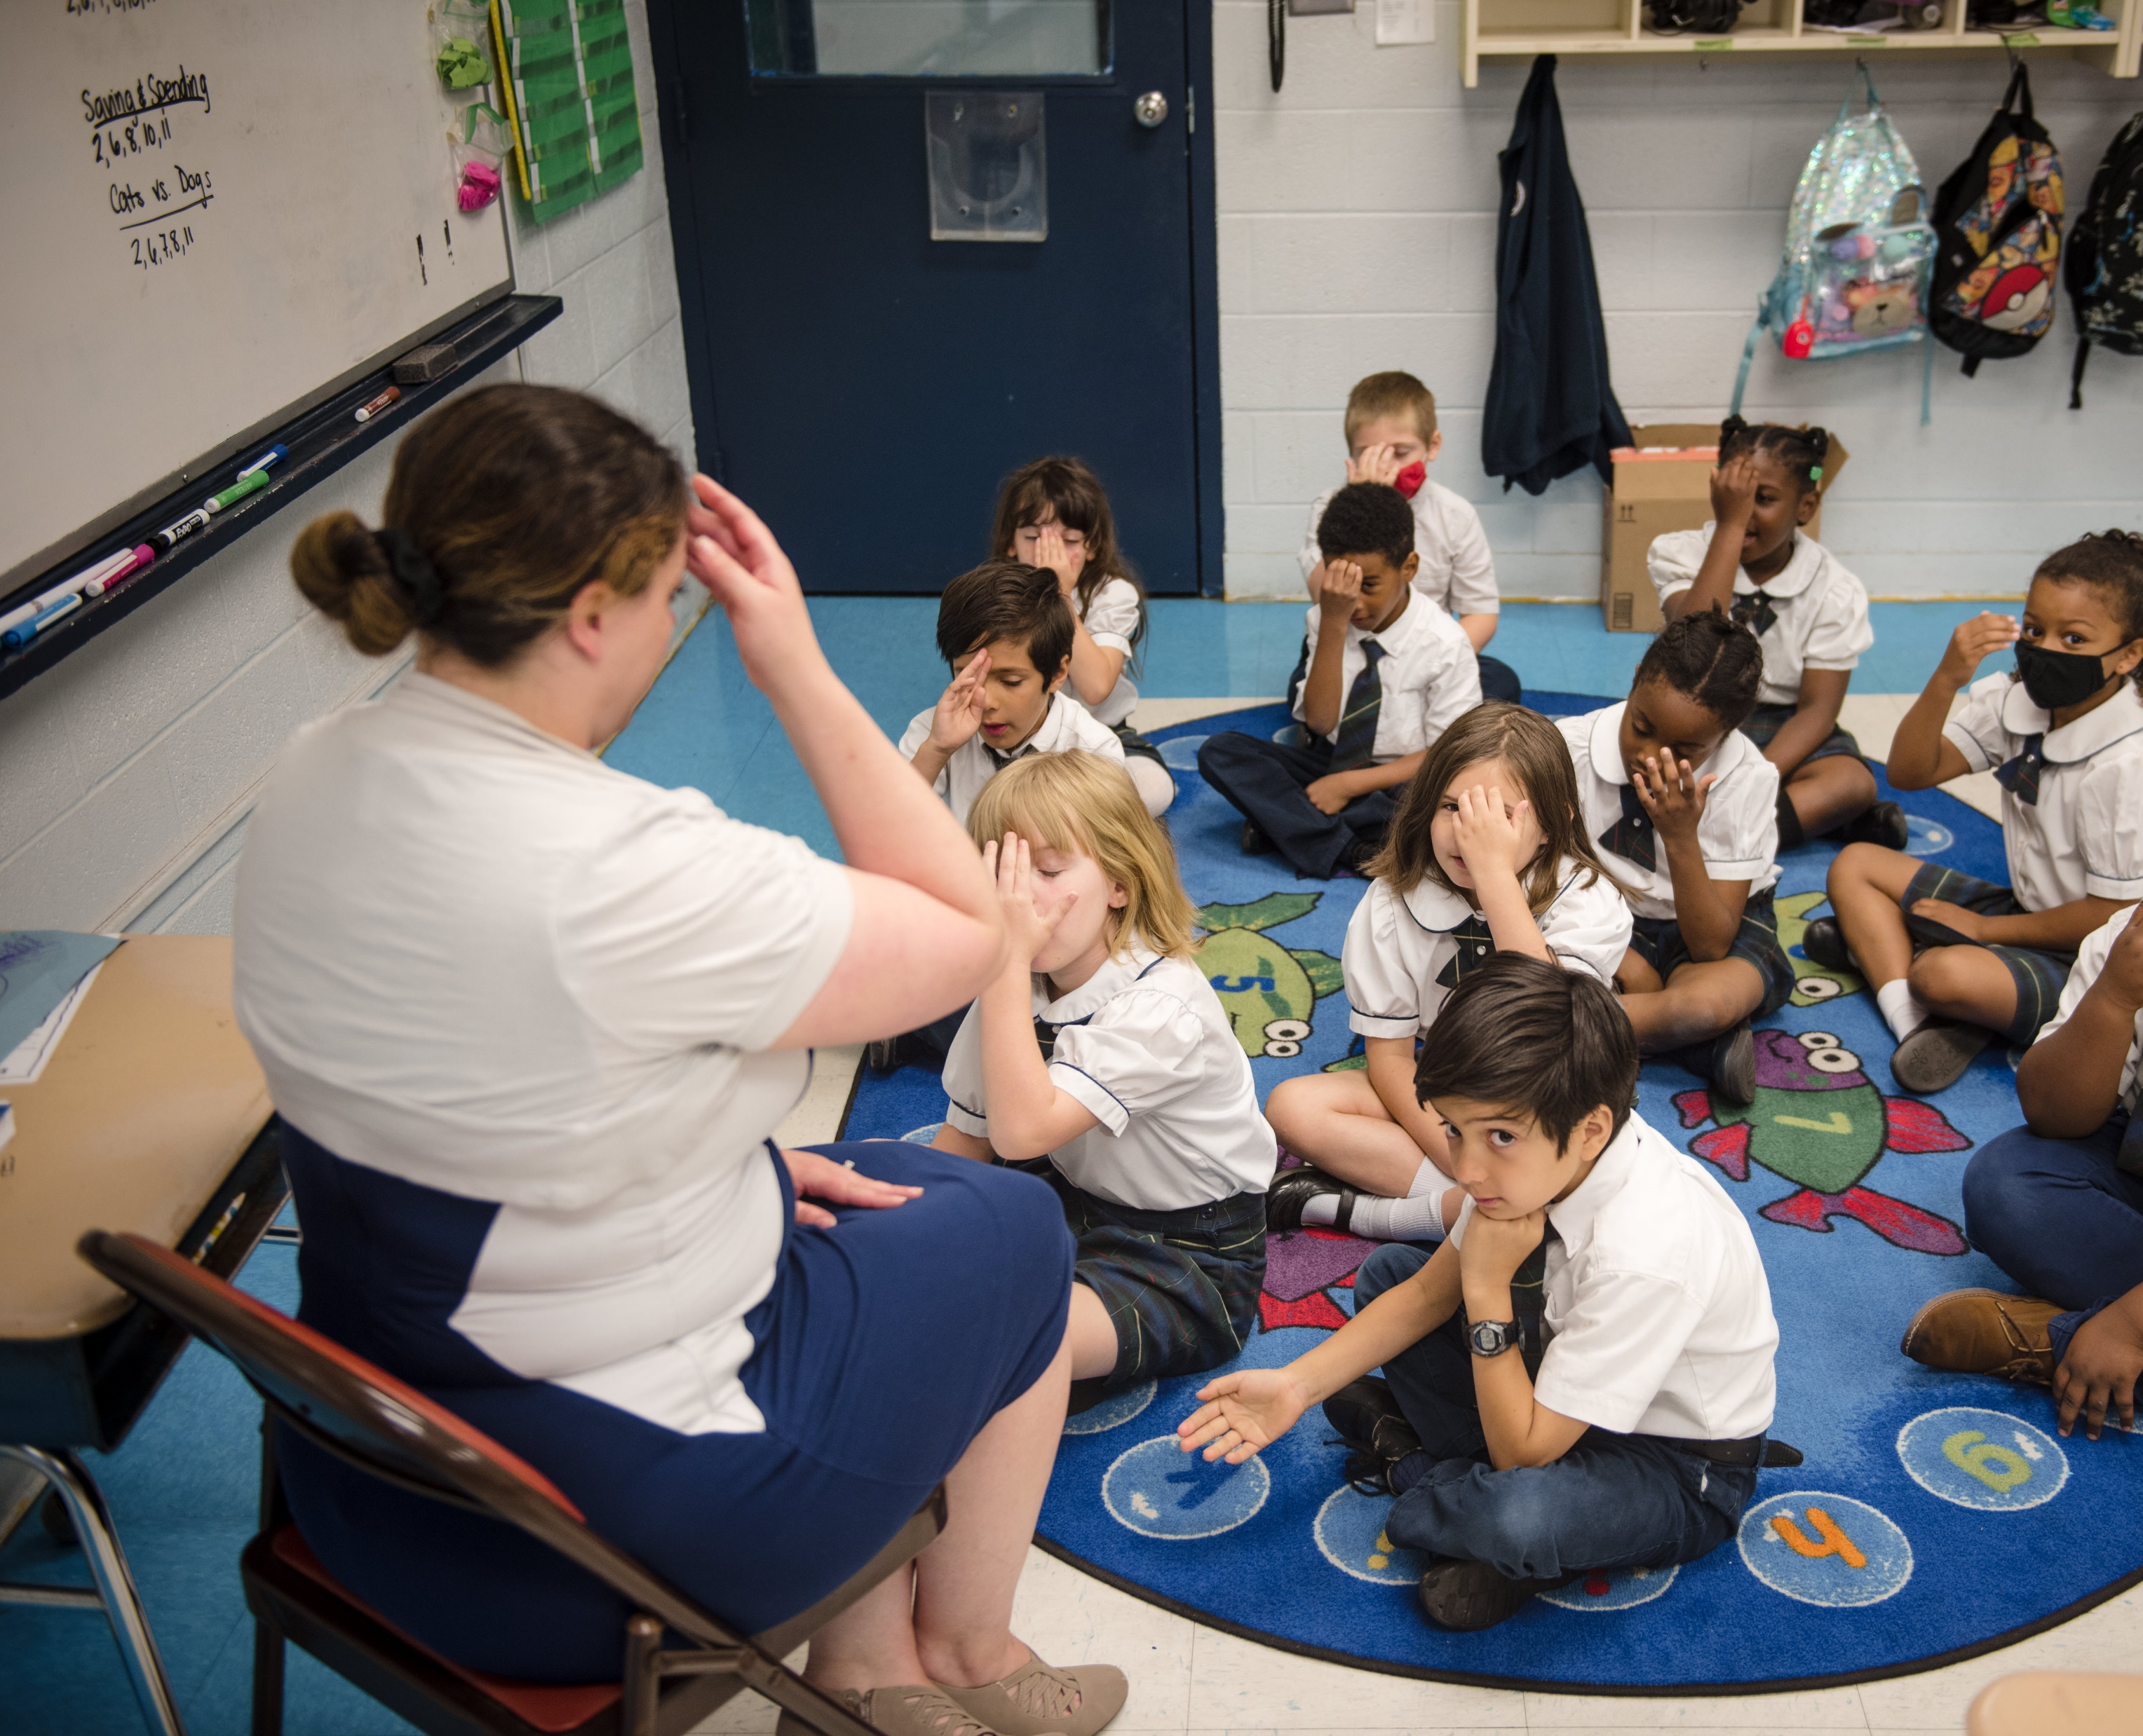
OPERATIONAL VITALITY Enrollment Management Teams
One day we will:
Be accessible to and inclusive of any student regardless of socio-economic status, race, cultural background, religious affiliation or learning exceptionality.
We will retain and attract students so that every seat in every classroom in every school will be filled.

Slide 6
Catholic Schools Week 2024 Sunday, Jan. 28 - Sat. Feb. 3
New theme!
“United in Faith and Community”
Marketing Kit is available at ncea.org/csw
Please tag NCEA on Facebook, LinkedIn and Twitter, plus use the hashtag #CSW2024, so we can share your information!
Order Catholic Schools Week swag with the new logo and theme at www.catholicschoolpride.com
Link to last year’s plans: HERE

Slide 7
Catholic Schools Week 2024 Sunday: Celebrating Your Parish
Highlights from last year: Serving in Mass (read, usher, sing), food collection, wearing uniforms to Mass (offering dress-down passes for a school day, educators at Mass in a drawing for a gift card), Open House for prospective families and parishioners, pancake breakfast
Plans for this year

Slide 8
Catholic Schools Week 2024 Monday: Celebrating Your Community
Highlights from last year: Dress down day, drum performance, window cling giveaway, students dress as community helpers, game night for families, family-student lunch, thank you cards to parents (Butterfly with “Your gift of a Catholic Education helps me soar!”), donations for Catholic Charities, donations of socks and pet food, thank you notes to EMTs, fire and police
Plans for this year

Slide 9
Catholic Schools Week 2024 Tuesday, Celebrating Your Students
Highlights from last year: Doughnuts, pajama day, dress down, ice pops, crazy socks, writing prayer intentions, cookies, skate night, family lunch, dress to impress, Muffins with Moms, Doughnuts with Dads (consider… “A festival of friends/family” “Flavors with friends/family”), magic show with popcorn
Plans for this year

Slide 10
Catholic Schools Week 2024 Wednesday: Celebrating the Nation
Highlights from last year: Students wear red, white and blue or military representation, Knights of Columbus flag lesson, military guests invited to speak, thank you cards for veterans/active duty, rosary for our troops/nation
Plans for this year

Slide 11
Catholic Schools Week 2024 Thursday: Celebrating Vocations
Highlights from last year: Invite priests for morning prayer, vocation story videos, hat day (what hat will you wear, who is God calling you to be?), write letters of thanks to priests, deacons and seminarians, students wear light blue for the intercession of Mary, Eucharistic Adoration
Plans for this year

Slide 12
Catholic Schools Week 2024 Friday: Celebrating Faculty, Staff and Volunteers
Highlights from last year: Staff v 8th grade volleyball, lunches for teachers, volunteer appreciation brunch after Mass, Pep Rally, involving school advisory board, invite grandparents and grandfriends, thank you items for faculty and staff, family game show event, students bring a single flower
Plans for this year

Slide 13
Catholic Schools Week 2024 Saturday: Celebrating Families
Highlights from last year: Annual Gala, presence at all Saturday Masses, display table, video looping, wear uniforms, skate night
Plans for this year

Slide 14
Discussion: How do these plans recruit/retain families?
Share your thoughts!

Slide 15
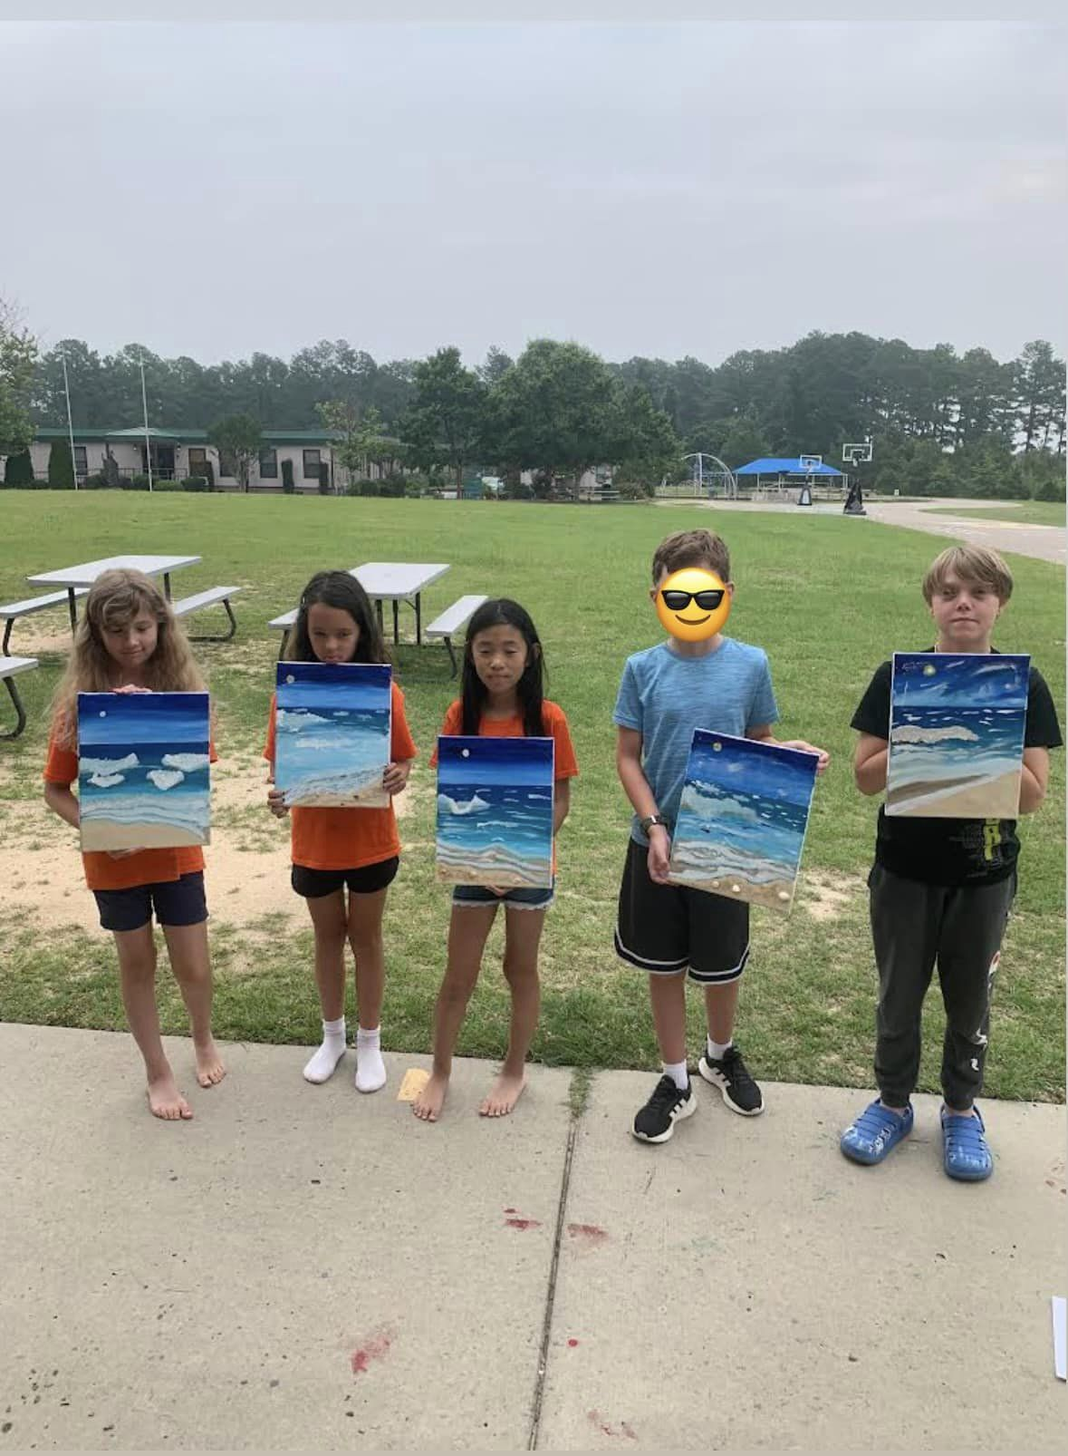
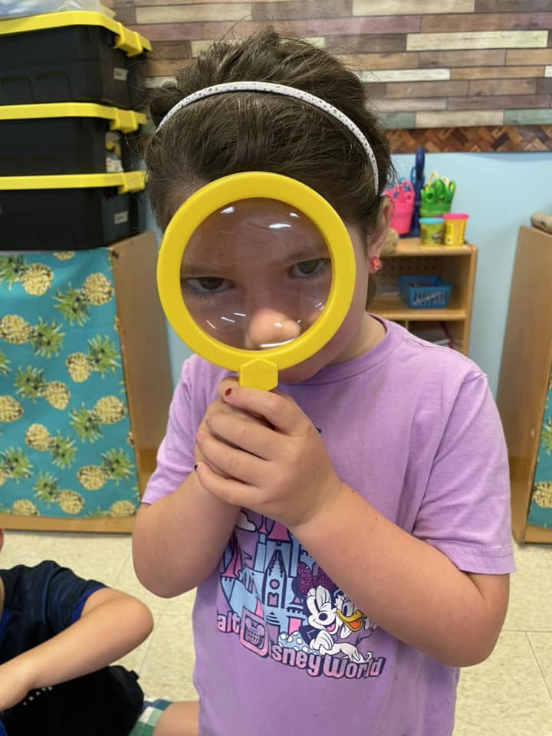
Summer Camps for Recruitment and Retention
Engaging prospective parents and communicating with your families is a year-round effort.
Summer camps keep campus “alive'' during the summer months.
Specialty and summer camps and courses are important avenues to introduce your school to the external community and anyone who may not be familiar with your campus or programs during the academic year.

Slide 16
Summer Camps for Recruitment and Retention
Engaging prospective parents and communicating with your families is a year-round effort.
Considering creative and engaging ways to keep campus “alive'' during the summer months.

Slide 17
OPERATIONAL VITALITY Enrollment Management Meetings and Topics
Wed. Jan. 10, 10-11am Enrollment and Admissions for Operational Vitality
Wed. March 13, 10-11am Social Media Marketing

Slide 18
OPERATIONAL VITALITY Enrollment Management Training - Questions
One day we will:
Be accessible to and inclusive of any student regardless of socio-economic status, race, cultural background, religious affiliation or learning exceptionality.
We will retain and attract students so that every seat in every classroom in every school will be filled.

Slide 19
Prayer
Loving God,
You are present to us whenever we gather as a faith community.
We pray that our schools will be places where everyone feels accepted, safe, and beloved.
Help our schools and our local communities be places of faith so that we can help others believe in You.
Fill us with Your Spirit so that we may reflect Your light and love to each other and the whole world as one Body of Christ.
We ask this of Jesus, Your Son, who lives and reigns with You, in the unity of the Holy Spirit, one God, forever and ever.
Amen.
Notes:
Prayer before Meetings
Heavenly Father, as we enter into this meeting, we bring your presence with us. We speak your peace, your grace, your mercy, and your perfect order. We acknowledge your power over all that will be spoken, thought, discussed, decided, and done during our meeting.
Lord, we thank you for the gifts you have given to us and we commit to using them responsibly in your honor. Give us a fresh supply of strength and compassion to do our job. Anoint our plans, ideas, and energies so that even our smallest accomplishment may bring you glory.
Lord, when we are confused, guide us, when we are anxious, comfort us, and when we are tired, infuse with the fire of the Holy Spirit.
May the work that we do and the way we do it bring faith, joy, and hope to all of those we serve today and every day.
We ask this through your son, Jesus Christ.
Amen.

